Slide 1
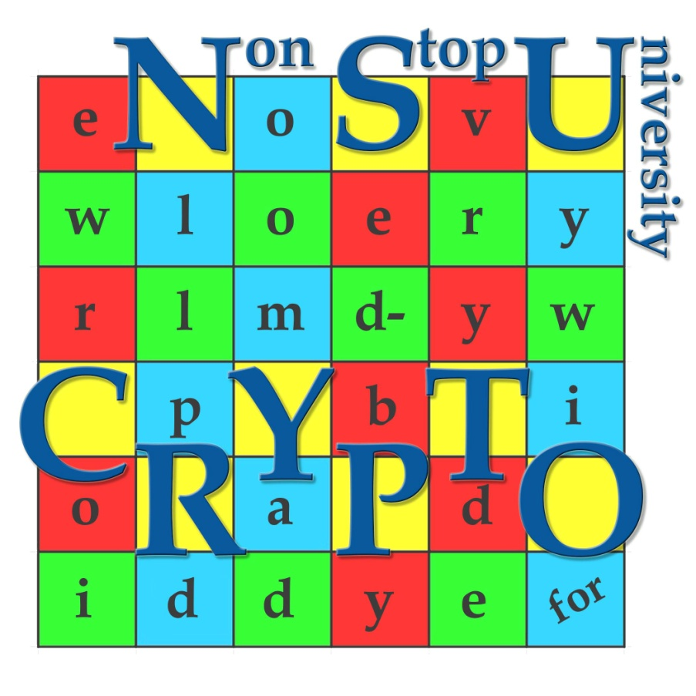
International Olympiad in Cryptography
Non-Stop University CRYPTO
Novosibirsk
Anastasiya Gorodilova
Natalia Tokareva
www.nsucrypto.nsu.ru

Slide 2
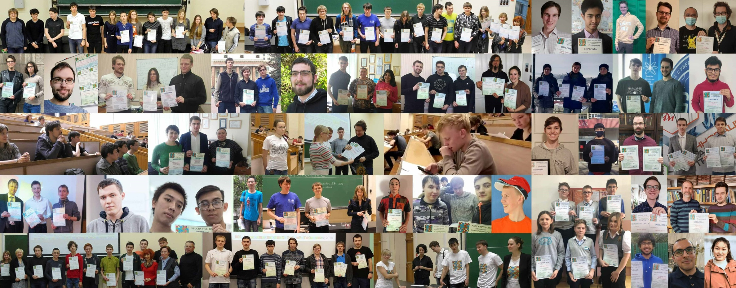
The International Olympiad in Cryptography
Non-Stop University CRYPTO (NSUCRYPTO)
More than 3000 participants
from 68 countries
in 2014 - 2021!

Slide 3
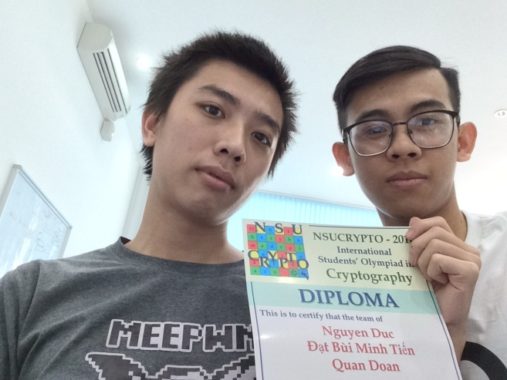
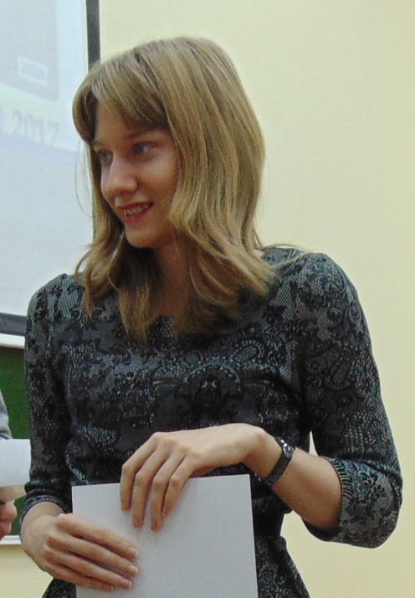
NSUCRYPTO Olympiad can even change people’s professional lives!
“Without having a 3rd ranking to go for PhD, I would give up in cryptography due to the complex mathematics involve.” — Duc Tri Nguyen (Vietnam, third place in 2016, 2017 and 2019, honorable Diploma in 2018)
“When we joined the competition, we just wanted to know where we were with our knowledge, wanted to test ourselves with our self-study Crypto, and wanted to improve our math in Cryptography.” — Quan Doan (Vietnam, third place in 2016, 2018 and 2019, honorable Diploma in 2018)
“I sometimes find myself reading too much and this competition is a great way of putting knowledge into practice by solving fun tasks.” — Dragos Alin Rotaru (United Kingdom, third place in 2016)
“Participation in the Olympiad offers you an excellent opportunity to try yourself as a codebreaker and a cryptographer.” — Anna Taranenko (Russia, first place in 2014, second place in 2015 and 2016, and honorable diploma in 2017)
nsucrypto.nsu.ru/feedbacks/

Slide 4
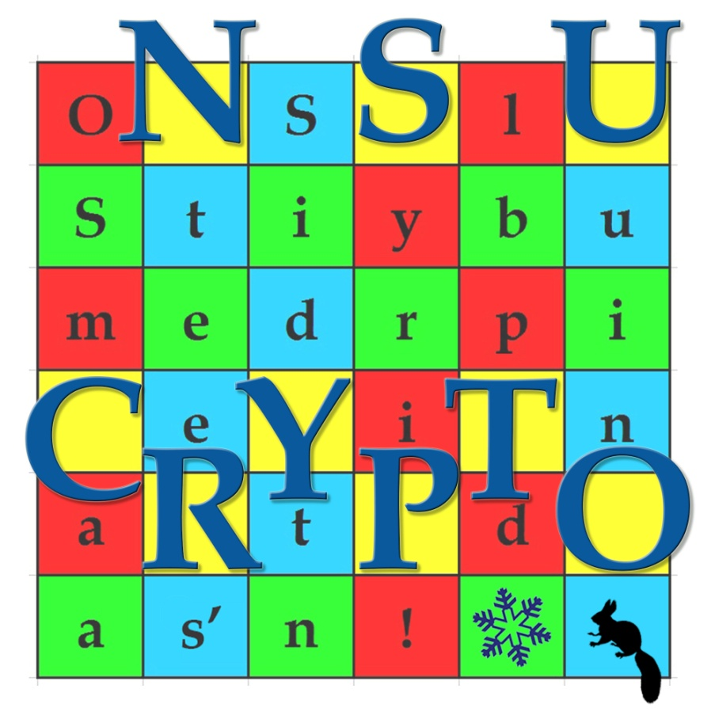
History of the Olympiad
Siberian Students’ Olympiad in Cryptography
with International Participation
NSUCRYPTO
The International Olympiad in Cryptography
Non-Stop University CRYPTO
nsucrypto.nsu.ru

Slide 5
Rules of the Olympiad or Why Non-Stop University CRYPTO?
Rounds of the Olympiad. There are two independent the Internet rounds.
The First round (duration 4 hours 30 minutes) is individual, consists of two sections:
A – “school section” B – “student section”
The Second round (duration 1 week) is team (up to 3 members).
Everybody could participate! Three categories of participants:
“school student” (for junior researchers: pupils and school students)
“university student” (for participants who are currently studying at universities)
“professional” (for participants who have already completed education or just want to be in the restriction-free category)
Language of the Olympiad. All problems are given in English. Please note all solutions should be written in English.
Format of the solutions. We accept solutions in any electronic format (pdf, jpg, txt, docx, etc).
nsucrypto.nsu.ru

Slide 6






Program committee
Sergey Agievich (Belarusian State University, Belarus’) | Ekaterina Malygina (Immanuel Kant Baltic Federal University, Russia)
Lilya Budaghyan (University of Bergen, Norway) | Nicky Mouha (Computer Security Division of NIST, USA)
Anne Canteaut (INRIA Paris, France) | Svetla Nikova (University of Leuven, Belgium)
Claude Carlet (University of Paris 8, France) | Irina Pankratova (Tomsk State University, Russia)
Joan Daemen (Radboud University, The Nerherlands) | Stjepan Picek (Delft University of Technology, The Netherlands)
Sugata Gangopadhyay (Indian Institute of Technology Roorkee, India) | Bart Preneel (University of Leuven, Belgium)
Evgeny Gorkunov (Novosibirsk State University, Russia) | Marina Pudovkina (Bauman Moscow State Technical University, Russia)
Anastasiya Gorodilova (Sobolev Institute of Mathematics, Russia) | Vincent Rijmen (University of Leuven, Belgium)
Tor Helleseth (University of Bergen, Norway) | Razvan Rosie (University of Luxembourg, Luxembourg)
Xiang-Dong Hou (University of South Florida, USA) | Alexander A. Semenov (Institute for System Dynamics and Control Theory, Russia)
Valeriya Idrisova (Sobolev Institute of Mathematics, Russia) | Francesco Sica (Nazarbayev University, Kazakhstan)
Konstantin Kalgin (Novosibirsk State University, Russia) | Pante Stanica (Naval Postgraduate School, USA)
Denis Kolegov (Tomsk State University, Russia) | Meltem Turan (National Institute of Standards and Technology, USA)
Nikolay Kolomeec (Sobolev Institute of Mathematics, Russia) | Aleksei Udovenko (CryptoExperts, France)
Alexander Kutsenko (Novosibirsk State University, Russia) | Andrey Zubkov (Steklov Mathematical Institute of RAS, Russia)
Natalia Tokareva (Novosibirsk State University, Russia), General chair
nsucrypto.nsu.ru

Slide 7
Organizations and sponsors
Organizations:
Cryptographic center (Novosibirsk)
Mathematical Center in Akademgorodok
Novosibirsk State University
Sobolev Institute of Mathematics
KU Leuven
Belarusian State University
Tomsk State University
Kovalevskaya North-West Centre of Mathematical Research
General sponsors:
Cryptographic center (Novosibirsk)
Mathematical Center in Akademgorodok
Novosibirsk State University
Kovalevskaya North-West Centre of Mathematical Research
HUAWEI CLOUD (in 2020)
nsucrypto.nsu.ru

Slide 8
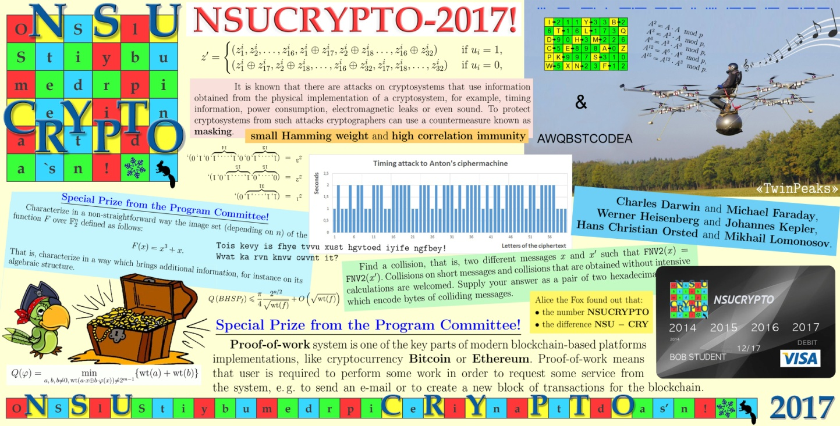
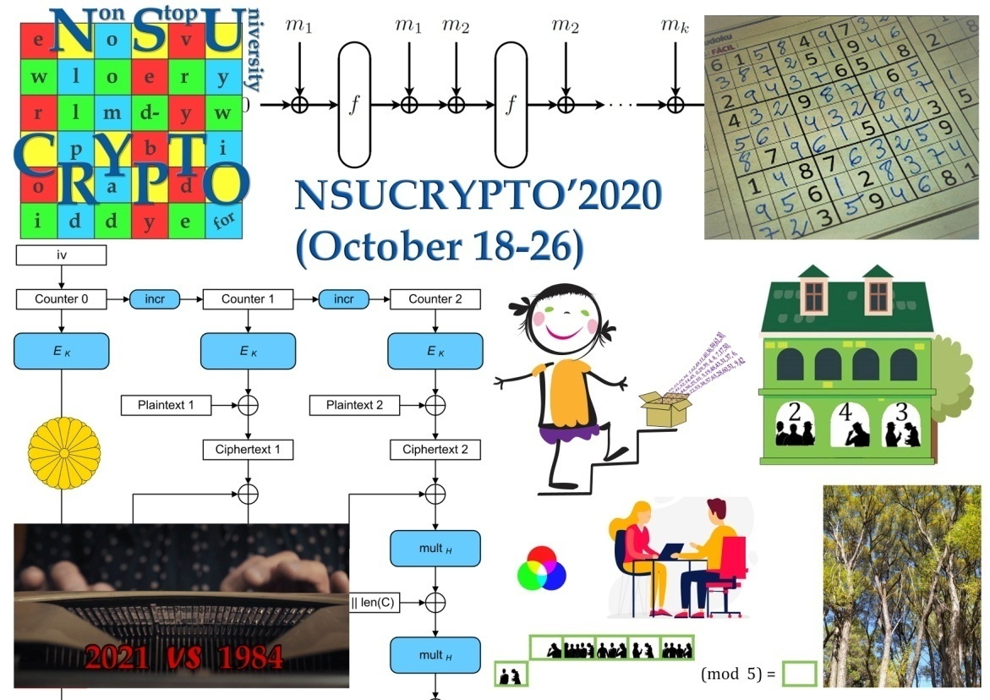
NSUCRYPTO problems…
nsucrypto.nsu.ru

Slide 9
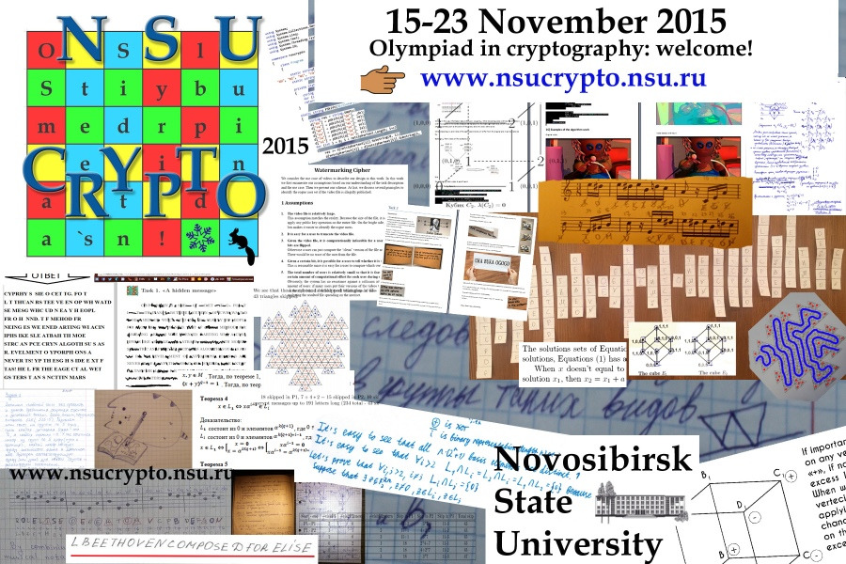
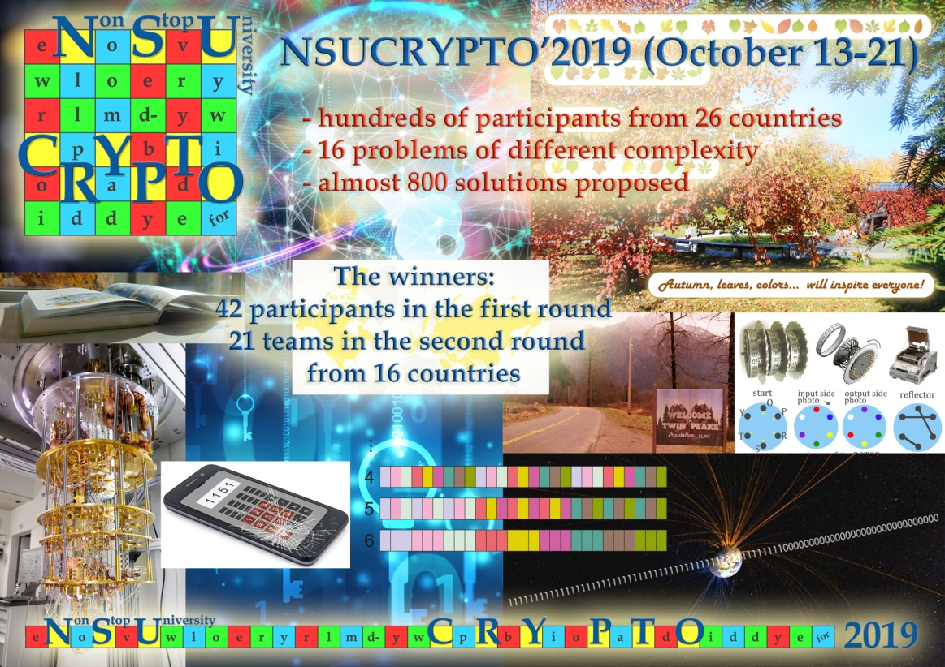
NSUCRYPTO problems… and their solutions!
nsucrypto.nsu.ru

Slide 10
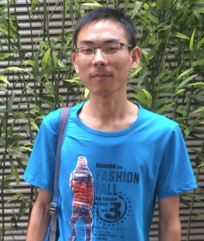
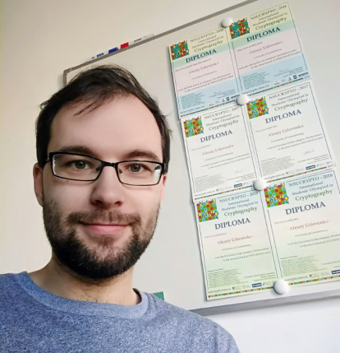
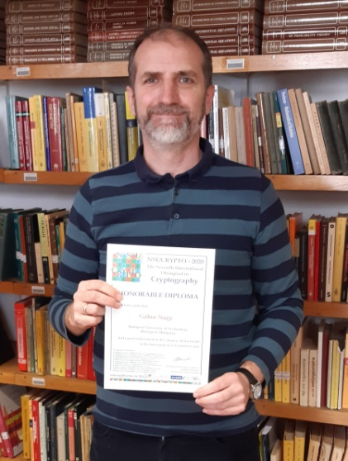
NSUCRYPTO problems… and their solutions!
Typical categories of problems:
“Fun tasks” includes
  School tasks
  Picture tasks
  Historical ciphers
  Mathematical tasks
  Programming tasks
  Online cipher machine
  Unsolved problems
  marked as
  “Problems for a special prize”
  “The problems contain much knowledge not only from mathematics and cryptography, but also from many other fields such as art.”
  — Renzhang Liu (China, first place in 2015)
  “The problems are scientific, challenging and very interesting. They are very diverse - from blockchains and quantum algorithms to Boolean functions and number theory.”
  — Aleksei Udovenko (Luxembourg, first place in 2014-2018, third place in 2014 and 2015)
  “The Olympiad enables us to let the best students of mathematics to get involved in this scientific domain, where pure mathematics, computer science, and engineering meet.”
  – Gabor P. Nagy (Hungary, first place in 2020 and 2021, Honorable diploma in 2020)
nsucrypto.nsu.ru

Slide 11
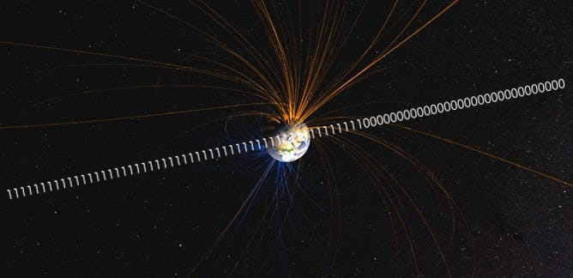
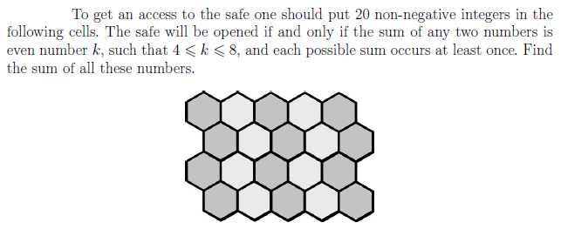
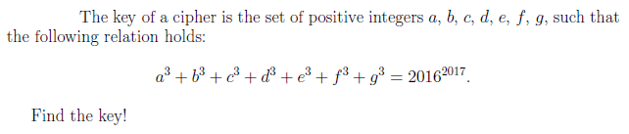
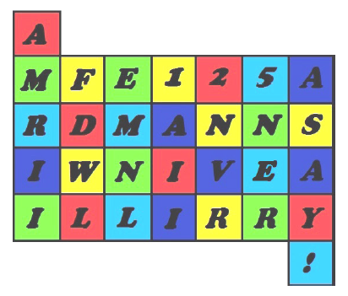
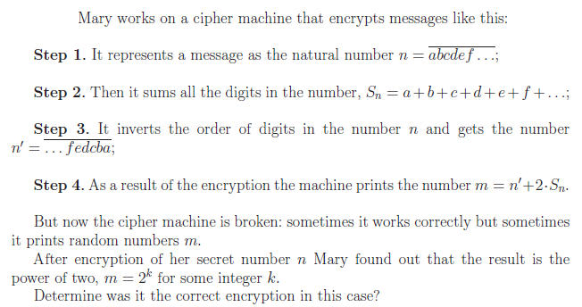
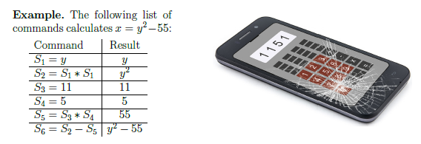
“Fun tasks”: School section tasks
nsucrypto.nsu.ru

Slide 12
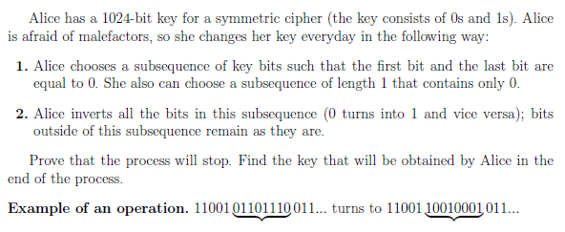
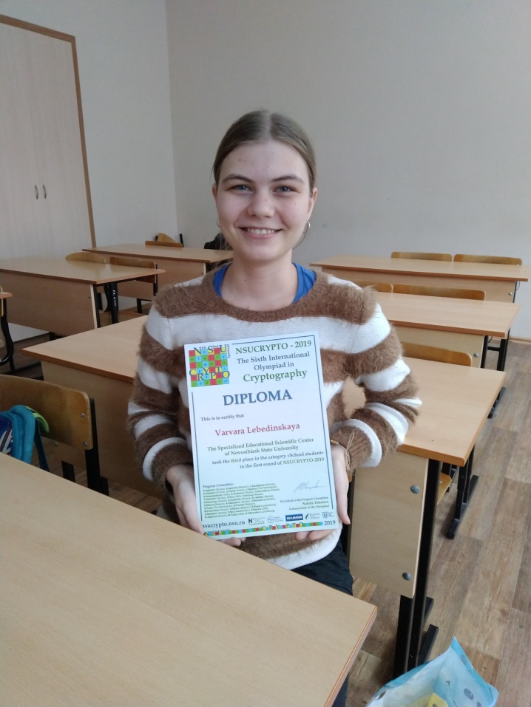
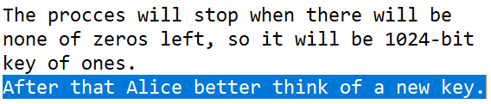
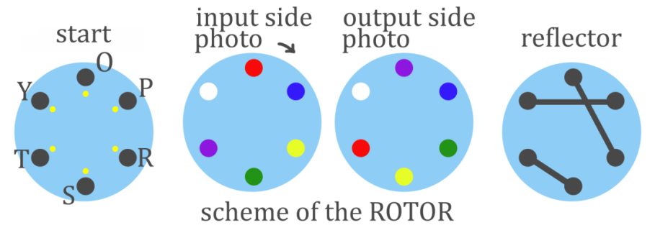
“Fun tasks”: School section tasks
Varvara Lebedinskaya
(Russia, Novosibirsk), 2019
nsucrypto.nsu.ru

Slide 13
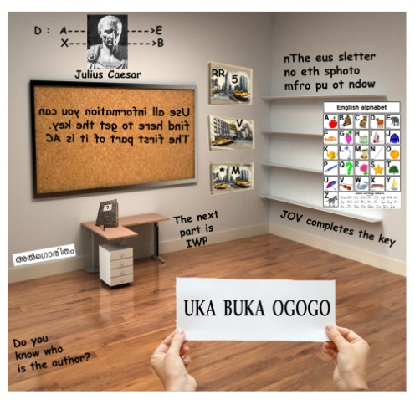
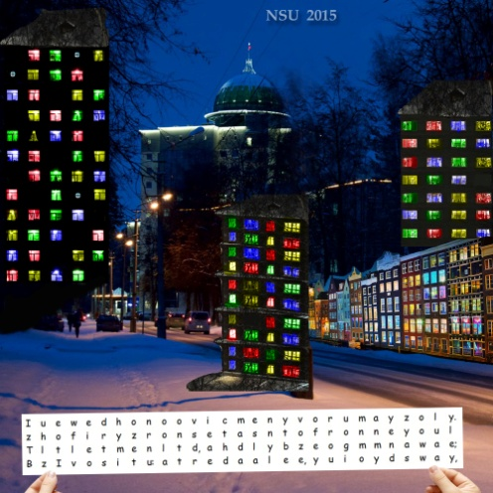
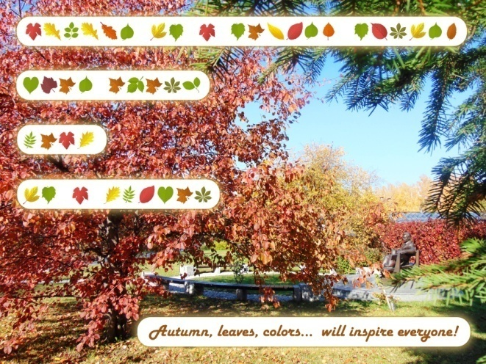
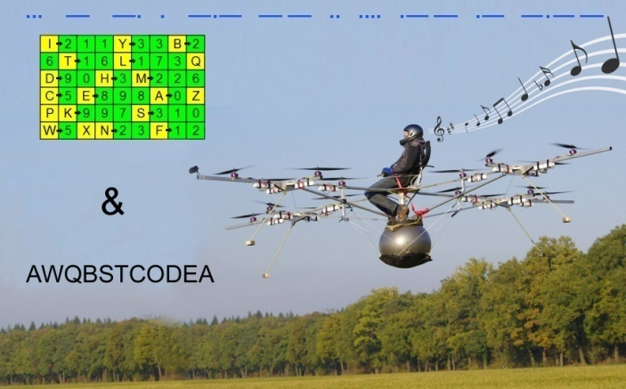
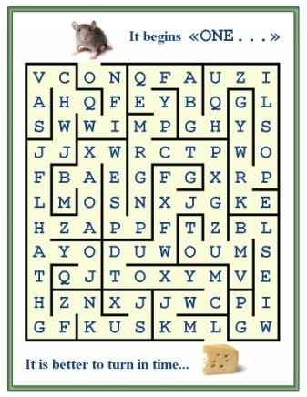
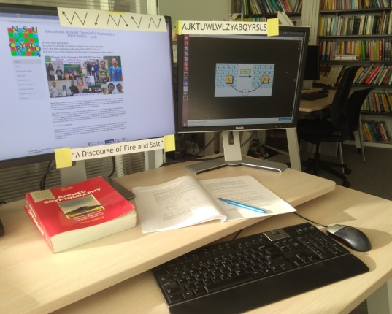
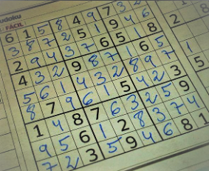
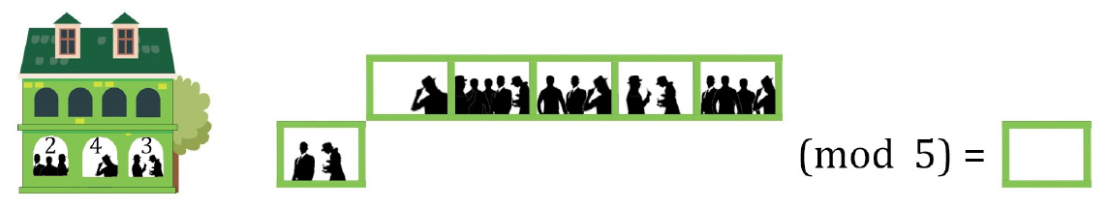
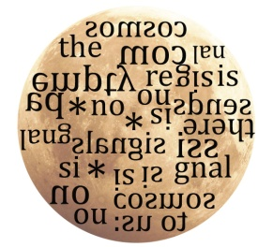
“Fun tasks”: Picture tasks
nsucrypto.nsu.ru

Slide 14

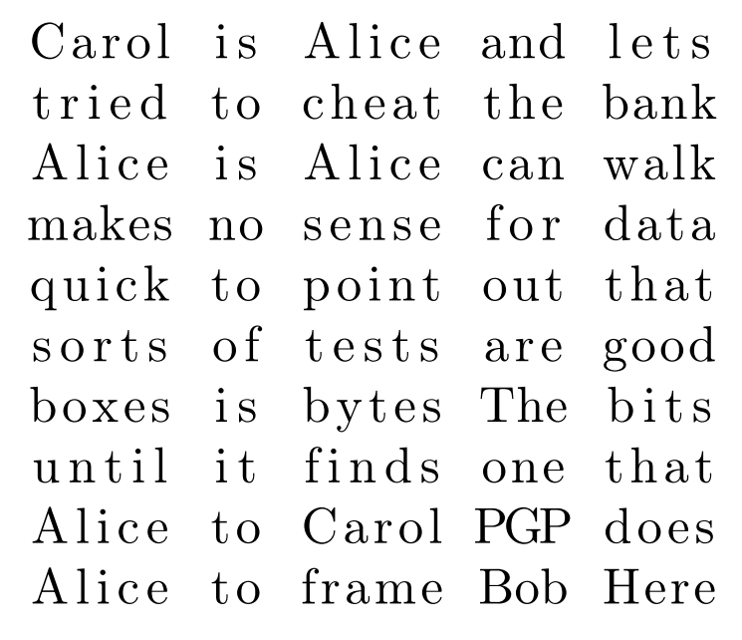
“Fun tasks”: Picture tasks
Aleksei Udovenko (Luxembourg), 2018
nsucrypto.nsu.ru

Slide 15
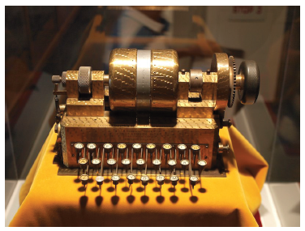
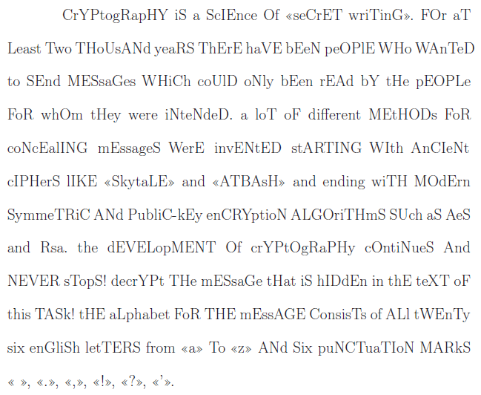
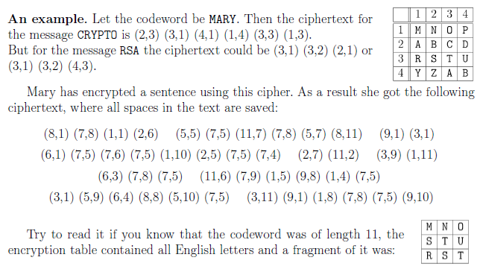
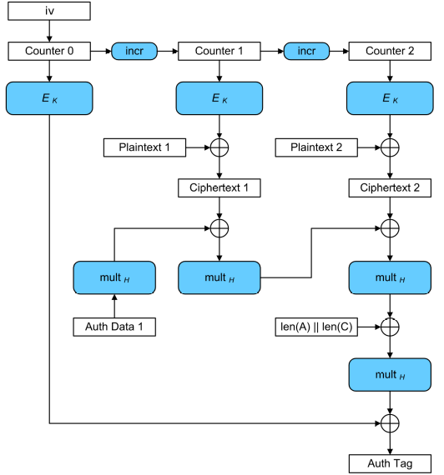
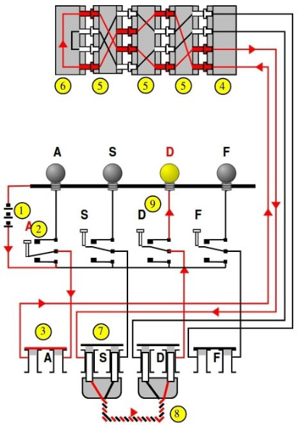
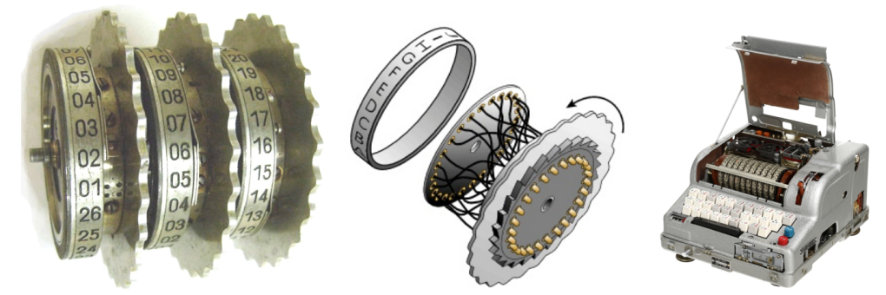
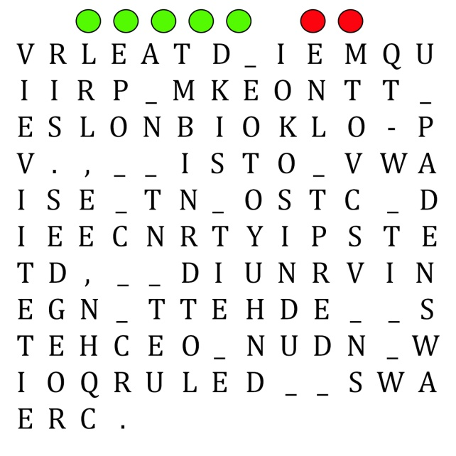
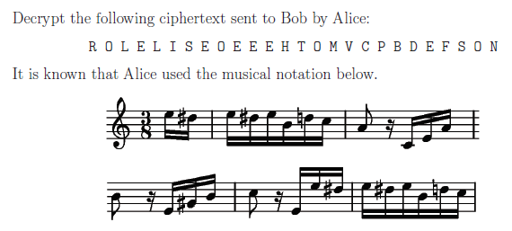
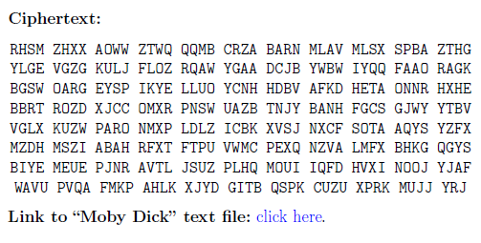
“Fun tasks”: Historical ciphers
nsucrypto.nsu.ru

Slide 16
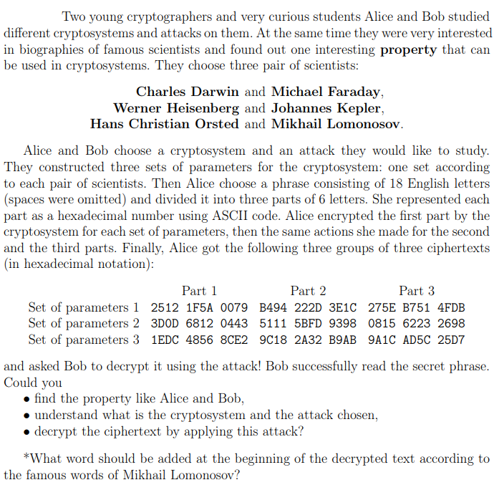
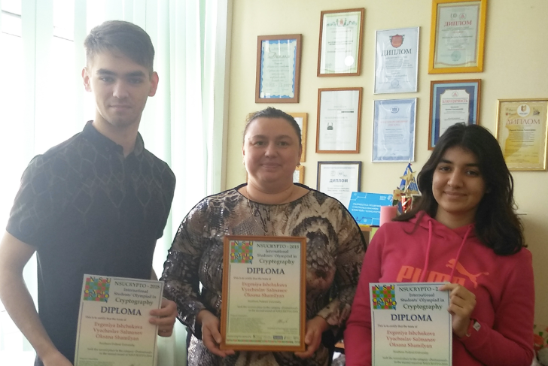
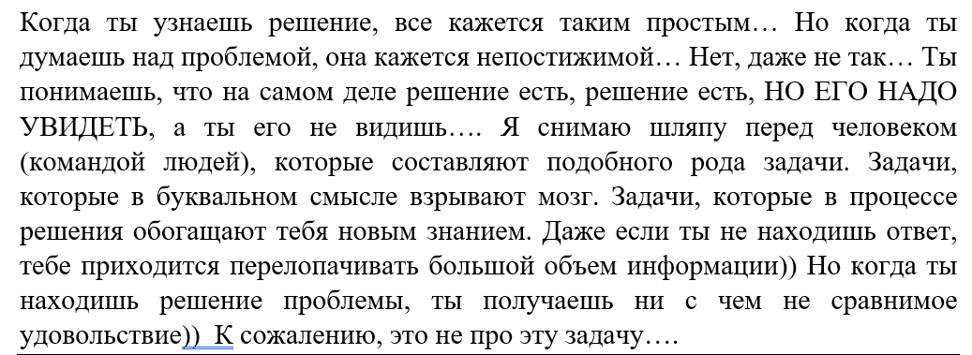
“Fun tasks”: Historical ciphers
“Sometimes you spend hours trying to solve a problem, sometimes it seems that it’s impossible to solve it. But when you find a solution, usually so obvious, you experience an incomparable sense of delight. My hat's off to the person who thinks up such interesting tasks!” — Evgeniya Ishchukova (Russia, third place in 2016, second place in 2018, honorable diplomas in 2015, 2017, 2019 and 2020).
nsucrypto.nsu.ru

Slide 17
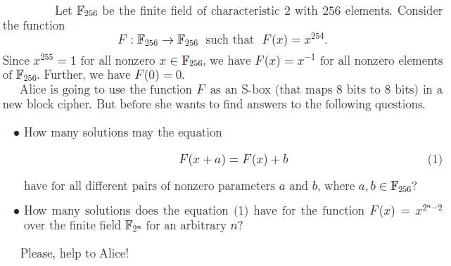
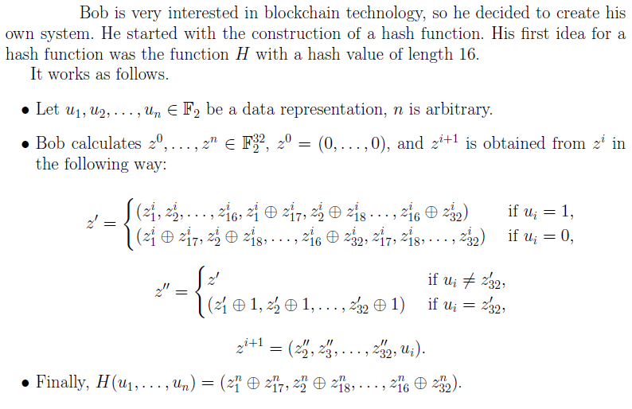
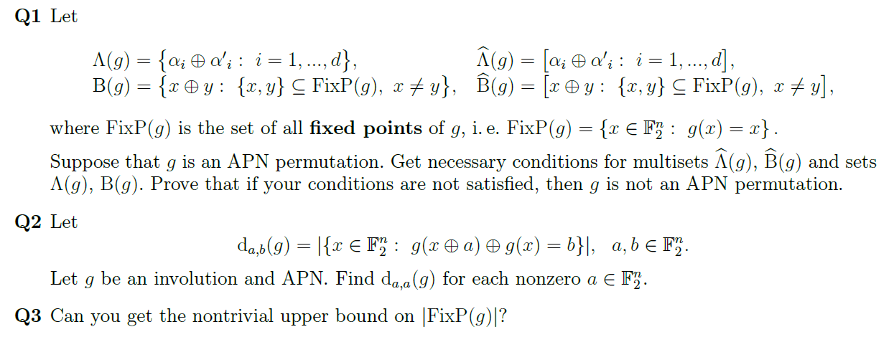

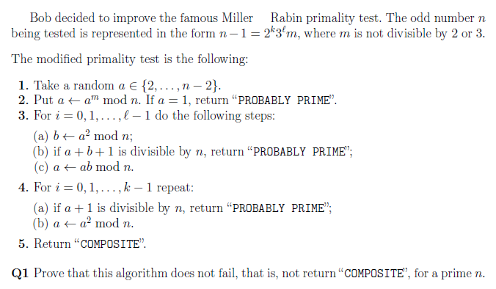
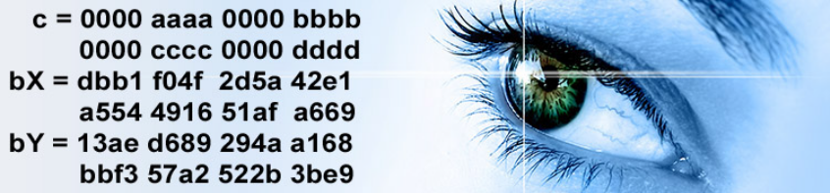
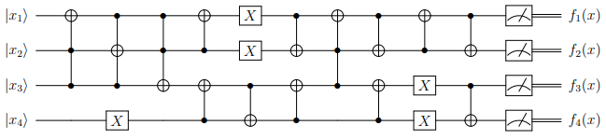

Mathematical tasks
nsucrypto.nsu.ru

Slide 18





Mathematical tasks
Henning Seidler,
Katja Stumpp
(Germany, Berlin),
2019
Madalina Bolboceanu
(Romania, Bucharest), 2019
nsucrypto.nsu.ru

Slide 19





Programming tasks
nsucrypto.nsu.ru

Slide 20



Programming tasks
Madalina Bolboceanu, Andrei Mogage, Radu Titiu (Romania, Bucharest), 2019
nsucrypto.nsu.ru

Slide 21





Online cipher machine
nsucrypto.nsu.ru

Slide 22

Online cipher machine
But another team realized exactly this number of queries….
Luckily, our server was OK :)
Aleksei Udovenko (Luxembourg), 2018
nsucrypto.nsu.ru

Slide 23



Online cipher machine
Mircea-Costin Preoteasa, Gabriel Tulba-Lecu, Ioan Dragomi (Romania), 2020
nsucrypto.nsu.ru

Slide 24
Unsolved problems
Year | Problem title | Status | Year | Problem title | Status
2014 | Watermarking cipher | Unsolved | 2019 | Sharing | Unsolved
2014 | APN permutation | Unsolved | 2019 | Curl27 | Partially SOLVED during the Olympiad
2014 | Super S-box | Unsolved | 2019 | 8-bit S-box | Unsolved
2015 | A secret sharing | Partially SOLVED in [1,2] | 2019 | APN + Involutions | Unsolved
2015 | Hypothesis | Unsolved | 2019 | Conjecture | Unsolved
2016 | Algebraic immunity | SOLVED during the Olympiad | 2020 | JPEG Encoding | Unsolved
2016 | Big Fermat numbers | Unsolved | 2020 | Miller — Rabin revisited | SOLVED during the Olympiad
2017 | The image set | Unsolved | 2020 | Bases | Partially SOLVED during the Olympiad
2017 | Boolean hidden shift problem | Unsolved | 2020 | AES-GCM | Unsolved
2017 | Useful Proof-of-work for blockchains | Unsolved | 2021 | Let’s find permutations! | Unsolved
2018 | Orthogonal arrays | SOLVED in [3] | 2021 | s-Boolean sharing | Partially SOLVED during the Olympiad
2018 | Sylvester matrices | SOLVED during the Olympiad | 2021 | Quantum error correction | Partially SOLVED during the Olympiad
2018 | Disjunct Matrices | Unsolved | 2021 | Distance to affine functions | Unsolved
Geut K., Kirienko K., Sadkov P., Taskin R., Titov S. On explicit constructions for solving the problem ‘A secret sharing’. ПДМ, 2017, 10, 68–70.
S.M. Ayat, M. Ghahramani, A recursive algorithm for solving «A secret sharing» problem, Cryptologia, 43:6 (2019), 497–503.
Kiss R., Nagy G. P. On the nonexistence of certain orthogonal arrays of strength four. ПДМ, 2021, 52, 65–68.
nsucrypto.nsu.ru/unsolved-problems/

Slide 25




Unsolved problems
nsucrypto.nsu.ru/unsolved-problems/

Slide 26

Unsolved problems
“It’s a contest that leaves you wanting to spend more time on it after the deadline, just to work out the questions you didn’t get.” — Robert Spencer (United Kingdom, first place in 2016, second place in 2017)
nsucrypto.nsu.ru/unsolved-problems/

Slide 27


Unsolved problems: solutions in publications
2018 Orthogonal arrays
SOLVED in
Kiss R., Nagy G. P. On the nonexistence of certain orthogonal arrays of strength four. ПДМ, 2021, 52, 65–68.
Gabor P. Nagy (Hungary), 2020
nsucrypto.nsu.ru

Slide 28



Unsolved problems: solutions in publications
2015 A secret sharing
Partially SOLVED in
Geut K., Kirienko K., Sadkov P., Taskin R., Titov S. On explicit constructions for solving the problem “A secret sharing” // Prikladnaya Diskretnaya Matematika. Prilozhenie. 2017. №10. P.68–70. (in Russian)
SIBECRYPT-2019 – two talks on
this problem
Partially SOLVED (recursively) in
S.M. Ayat, M. Ghahramani, A recursive algorithm for solving «A secret sharing» problem, Cryptologia, 43:6 (2019), 497–503.
nsucrypto.nsu.ru

Slide 29







Unsolved problems: solutions during the Olympiad
2016 Algebraic immunity
SOLVED by Alexey Udovenko (Luxembourg)
2018 Sylvester matrices
SOLVED by 3 teams in the 2nd round
2020 Miller — Rabin revisited
SOLVED by 5 participants in the 1st round
by 9 teams in the 2nd round
Sergey Bystrevskii
(Russia)
Mohammad
Akbarizadeh (Iran)
Gábor V. Nagy, Gábor P. Nagy,
Lajos Győrffy (Hungary)
nsucrypto.nsu.ru

Slide 30




Unsolved problems: solutions during the Olympiad
2019 Curl27
Partially SOLVED by
Jeremy Jean
(France, Paris)
2020 Bases
Partially SOLVED by the team of
Mikhail Kudinov,
Alexey Zelenetskiy,
Denis Nabokov
(Russia, Moscow)
Jeremy Jean (France, Paris)
nsucrypto.nsu.ru

Slide 31


Unsolved problems: solutions during the Olympiad
2021 Quantum error correction
Partially SOLVED by the team of
Viet-Sang Nguyen,
Nhat Linh Le Tan,
Nhat Huyen Tran Ngoc
(France, Paris)
2021 s-Boolean sharing
Partially SOLVED by the team of
Gongyu Shi,
Ruoyi Kong,
Haoxiang Jin
(China, Shanghai)
nsucrypto.nsu.ru

Slide 32

NSUCRYPTO – 2022: WELCOME!
Non-Stop University CRYPTO 2022
The first round – October 16
The second round – during October 17 - 24
“For me it's the most enjoyable Olympiad with beautiful problems, both challenging and interesting, and it motivates me to research new areas.
The fun is much worth the week-long hard work, try it yourself!”
— Maxim Plushkin (Russia, honorable Diploma in 2015, first place in 2016, 2018, 2019 and 2021, second place in 2016 and 2017, third place in 2019)
nsucrypto.nsu.ru

Slide 33

WELCOME video lecture from the world known cryptographer
In 2020, a new format started: 40-minutes video lecture from the world known cryptographer with greetings to participants and some scientific/popular information.
In 2020, the Review of AES proposed by NIST was presented at the first time in the history! It is done specially for NSUCRYPTO by Nicky Mouha.
nsucrypto.nsu.ru

Slide 34
Thank you for your attention!
tokareva@math.nsc.ru
nsucrypto.nsu.ru

